Slide 1
SECURE DATA HIDING IN IMAGES USING STEGANOGRAPHY
CAPSTONE PROJECT
Presented By:
Student Name : Mayank Rajgeet
College Name & Department : Galgotias University, School of Computer Science and Engineering

Slide 2
OUTLINE
Problem Statement
Technology used
Wow factor
End users
Result
Conclusion
Git-hub Link
Future scope

Slide 3
Problem Statement
With rising cyber threats, secure communication is essential to protect sensitive data.
Traditional encryption can attract attention, making messages a target for interception.
This project uses steganography with AES encryption to conceal secret messages within images, ensuring confidentiality.
The hidden data remains undetectable, providing a secure way to transmit information.

Slide 4
Technology used
Programming Language:
Python
Libraries Used:
OpenCV: For image processing (loading, modifying, and saving images).
NumPy: For efficient numerical operations and data manipulation.
PyCryptodome: For AES encryption and decryption of messages.
Base64: For encoding encrypted messages into a suitable format for hiding in images.
Hashlib: For generating secure password-based keys.
OS & Glob: For file handling and searching for image files.
Platform:
Windows (Compatible with other OS like Linux & macOS)
Python 3.x environment
GitHub (For project hosting and version control)

Slide 5
Wow factors
Enhanced Security with AES Encryption: Unlike basic steganography, this project combines encryption with hiding techniques, making data extraction nearly impossible without the correct password.
Randomized Pixel Encoding: Instead of sequential embedding, this method scatters data across the image using a password-derived randomization technique, enhancing security.
Supports Multiple Image Formats: Works seamlessly with PNG, JPG, BMP, and other formats, making it adaptable to various use cases.
Password-Protected Encoding & Decoding: Only authorized users with the correct password can retrieve the hidden message, preventing unauthorized access.
Minimal Image Distortion: Ensures that visual changes in the image are imperceptible, making detection of hidden data highly unlikely.
Cross-Platform Compatibility: Works on Windows, Linux, and macOS with minimal dependencies, making it easy to deploy anywhere.

Slide 6
End users
Cybersecurity Professionals: Useful for secure communication and protecting sensitive data from interception.
Government & Defense Agencies: Can be utilized for classified communication and covert data transfer.
Journalists & Whistleblowers: Helps in securely transmitting sensitive information without detection.
Corporate & Business Entities: Used to protect confidential documents and internal communications.
Law Enforcement Agencies: Assists in undercover operations and secure exchange of intelligence.
Individuals Concerned with Privacy: Useful for anyone who wants to protect personal data from prying eyes.

Slide 7
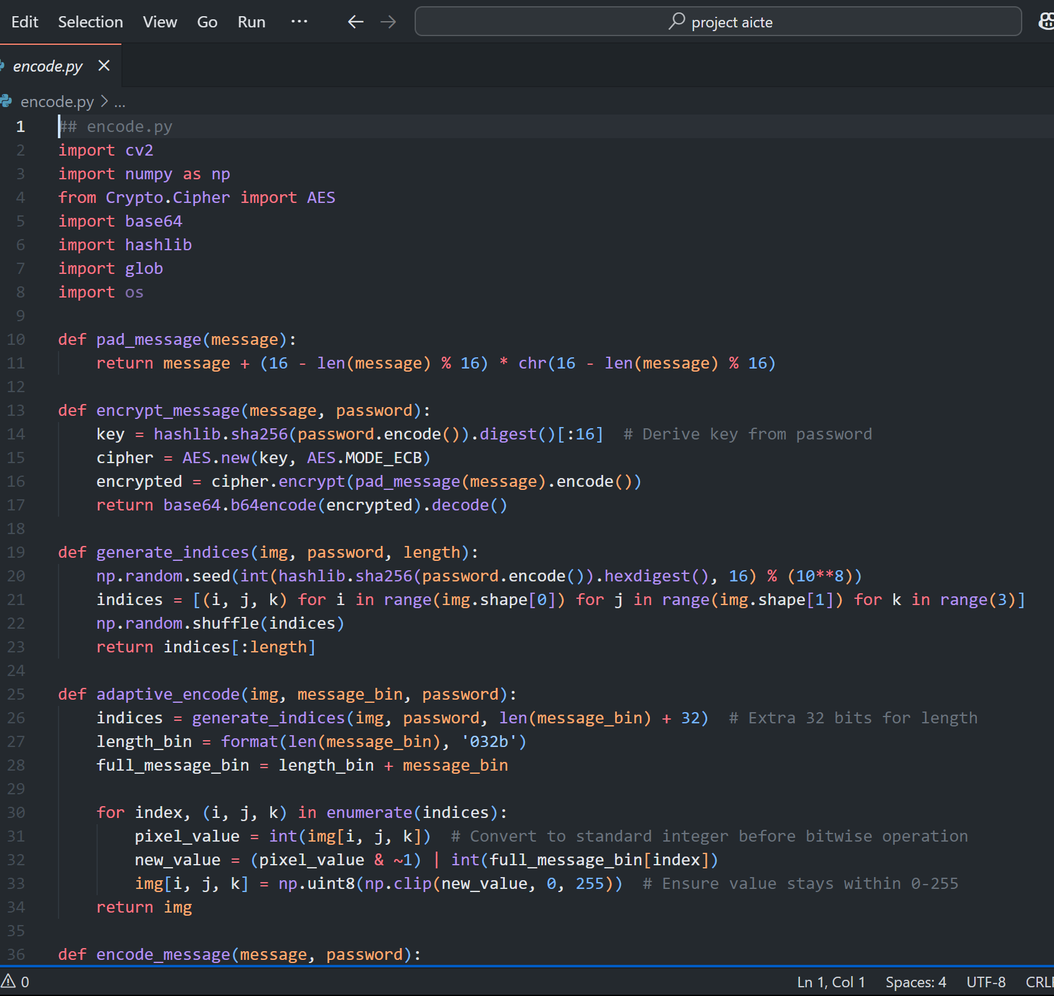
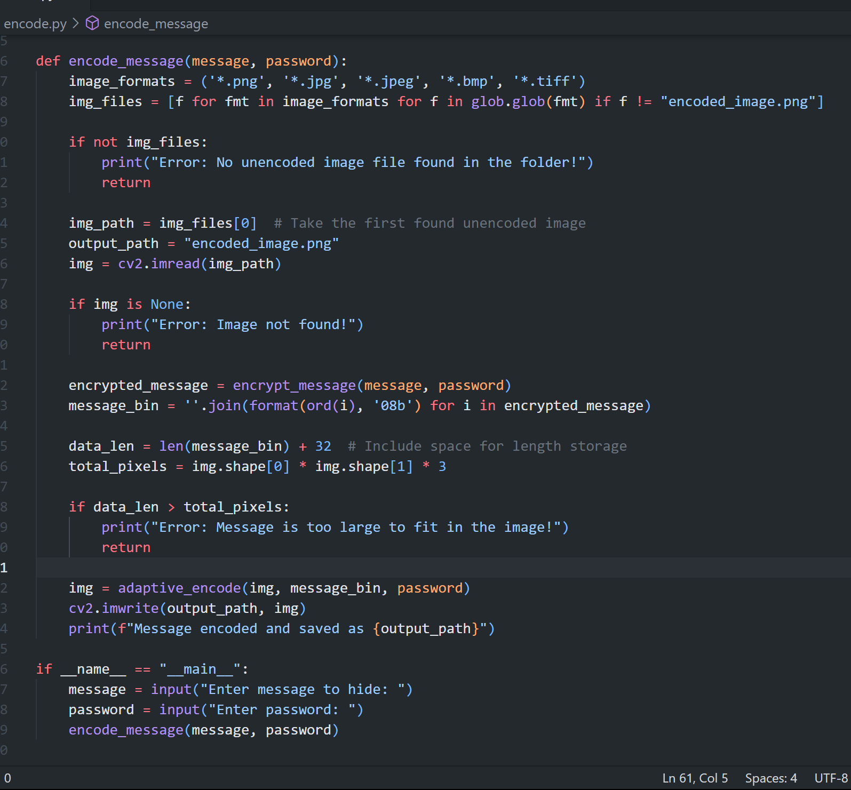
Results
SOURCE CODE: ENCODE.PY

Slide 8
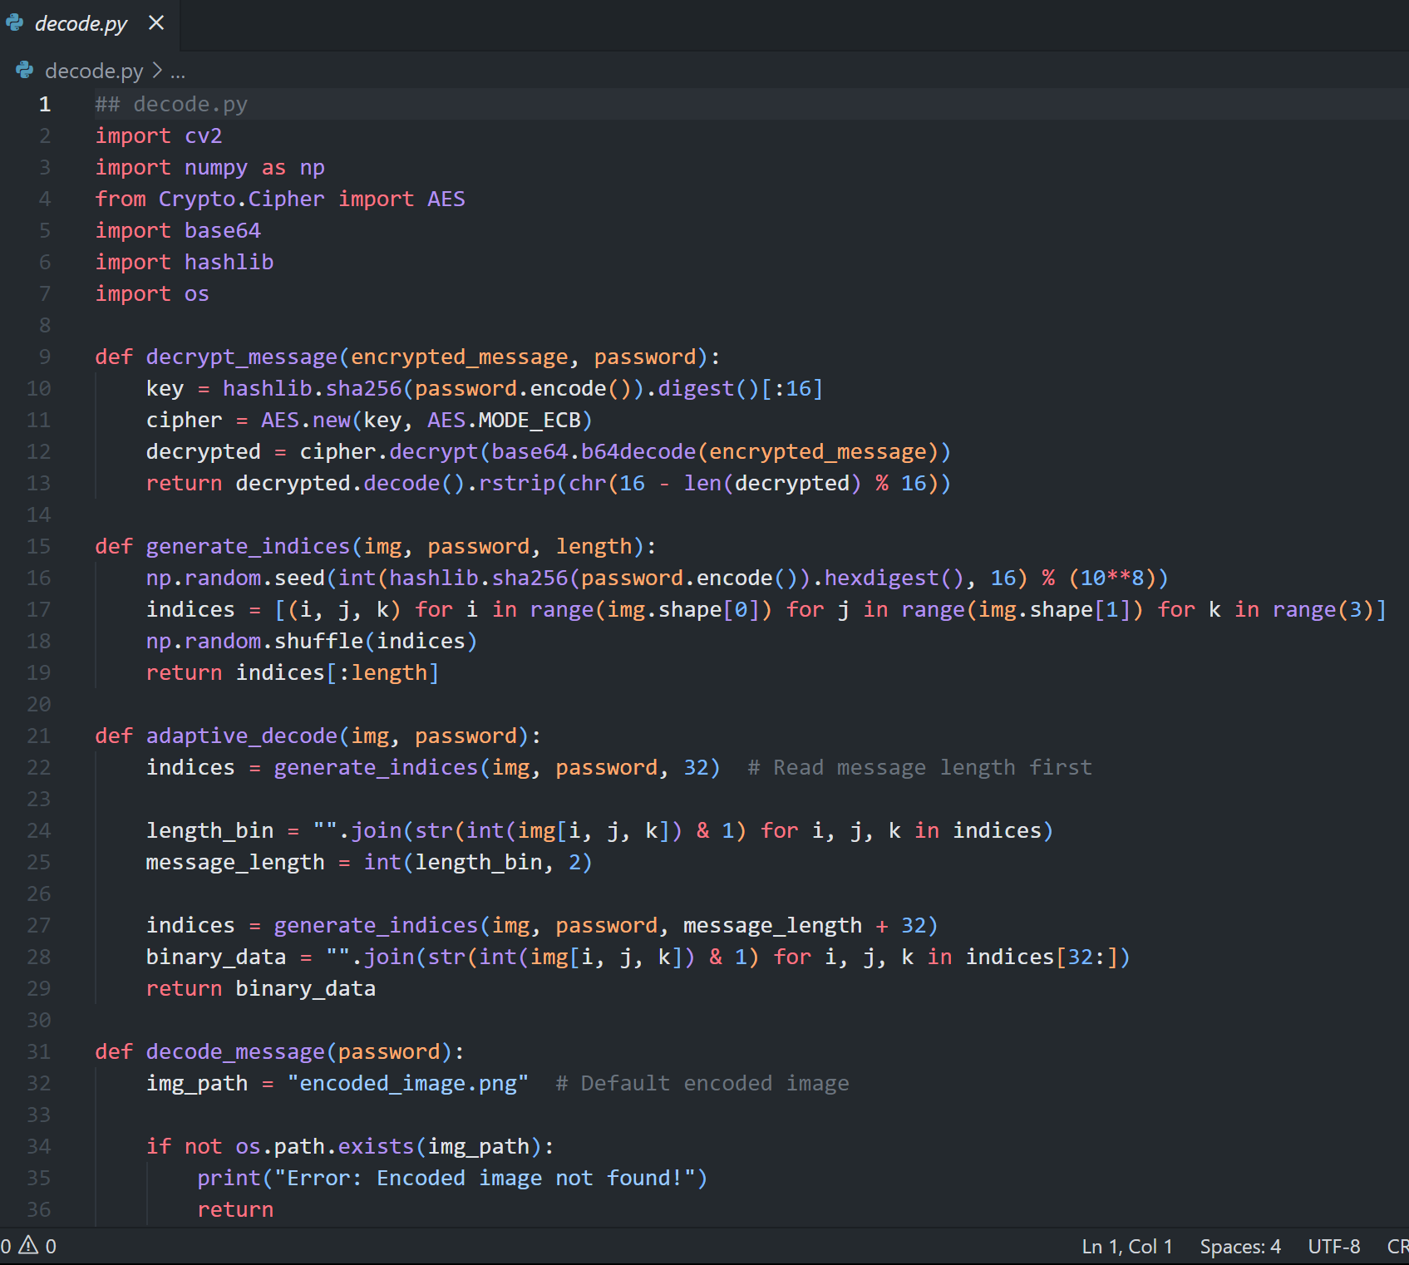
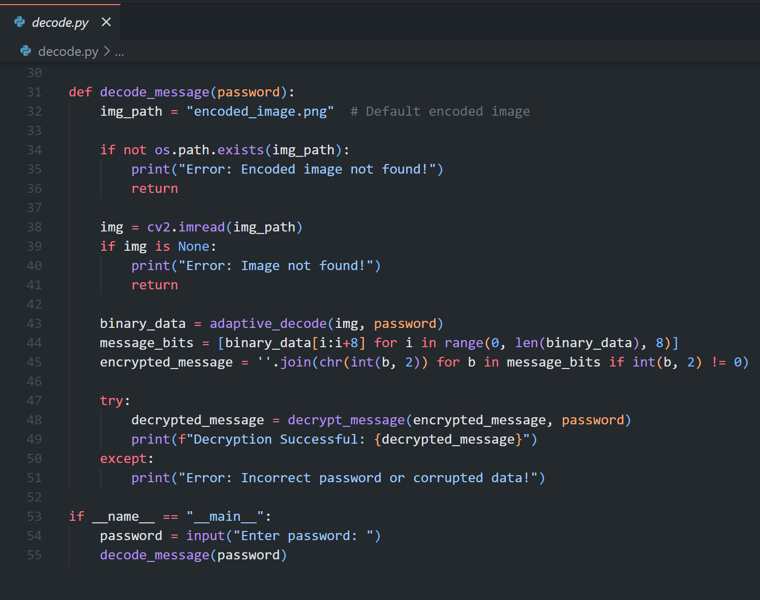
Results
SOURCE CODE: DECODE.PY

Slide 9
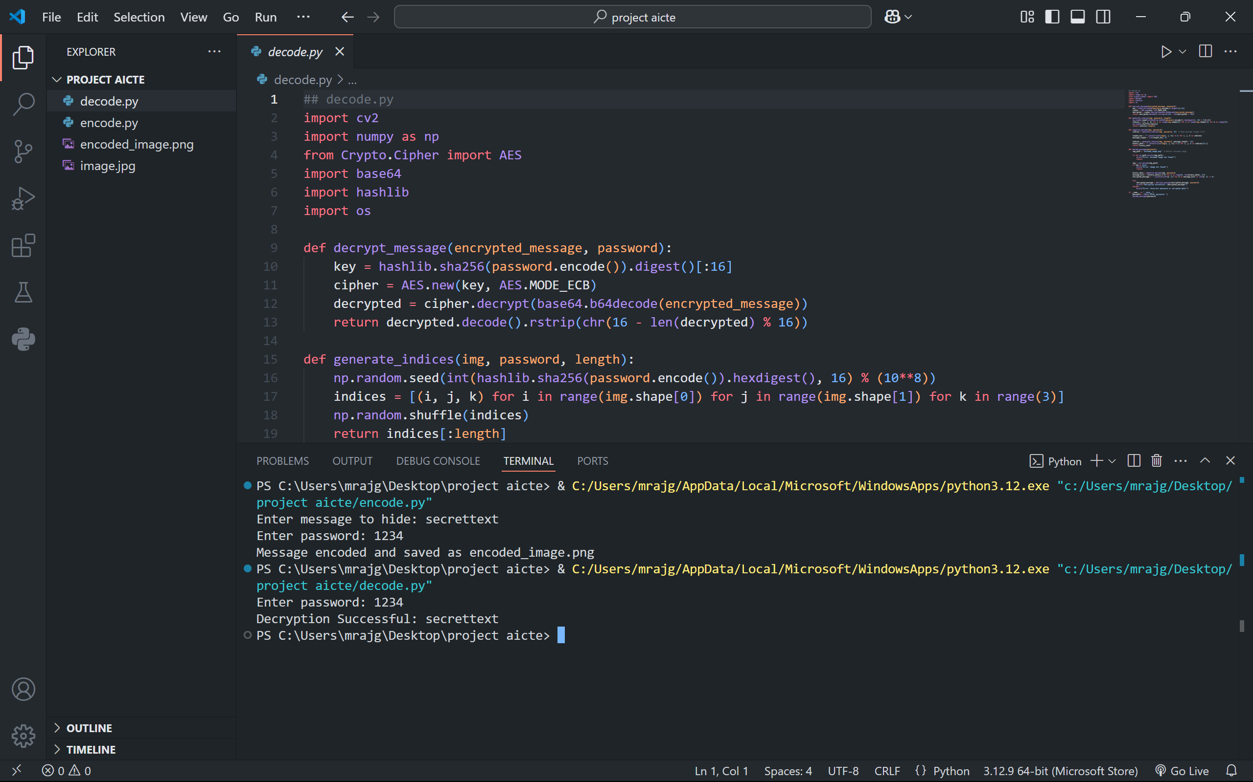
Results
Output Screenshot

Slide 10
Conclusion
This project successfully addresses the need for secure and discreet communication by integrating AES encryption with steganography. By embedding encrypted data within images using a randomized pixel approach, the system ensures confidentiality and prevents detection. The password-based access control further enhances security, making it accessible only to authorized users. This solution is highly applicable in cybersecurity, journalism, defense, and corporate sectors where data privacy and covert communication are crucial. Ultimately, this project demonstrates a practical and efficient approach to secure data transmission, mitigating risks of interception and unauthorized access.

Slide 11
GitHub Link
https://github.com/MayankRajgeet/Steganography-Encoder-Decoder.git

Slide 12
Future scope(optional)
Support for Video Steganography: Expanding the project to hide encrypted messages within video files, increasing security and capacity.
Integration with Cloud Storage: Enabling secure transmission and retrieval of encoded images through cloud platforms for accessibility and scalability.
AI-Powered Steganalysis Resistance: Implementing adaptive algorithms to counteract steganalysis techniques used to detect hidden messages.
Enhanced Encryption Mechanisms: Incorporating multi-layer encryption or hybrid cryptographic approaches for additional security.
Real-Time Mobile Applications: Developing a mobile-friendly version to facilitate secure communication on smartphones.
Cross-Media Steganography: Extending the project to support hiding encrypted data in audio files, documents, or other digital formats.
Blockchain-Based Authentication: Using blockchain technology to ensure tamper-proof authentication of encoded messages and prevent unauthorized modifications.
User-Friendly GUI: Enhancing usability by integrating a graphical user interface (GUI) for easier encoding and decoding without requiring technical expertise.

Slide 13
THANK YOU

